Slide 1
Residual Networks
and
Analyses
He, Kaiming, et al. "Deep Residual Learning for Image Recognition." arXiv preprint arXiv:1512.03385 (2015).
Andreas el. al. "Residual Networks are Exponential Ensembles of Relatively Shallow Networks." arXiv (2016).
Zagoruyko, Sergey, and Nikos Komodakis. "Wide Residual Networks." arXiv (2016).

Slide 2
Deep residual networks
152 layers network
1st place on ILSVRM 2015 classification task
1st place on ImageNet detection
1st place on ImageNet localization
1st place on COCO detection
1st place on COCO segmentation

Slide 3
Deeper Network?
Is deeper network always better?
What about vanishing/exploding gradients?
Better initialization methods / batch normalization / ReLU
Any other problems?
Overfitting?
Degradation problem: more depth but lower performance

Slide 4
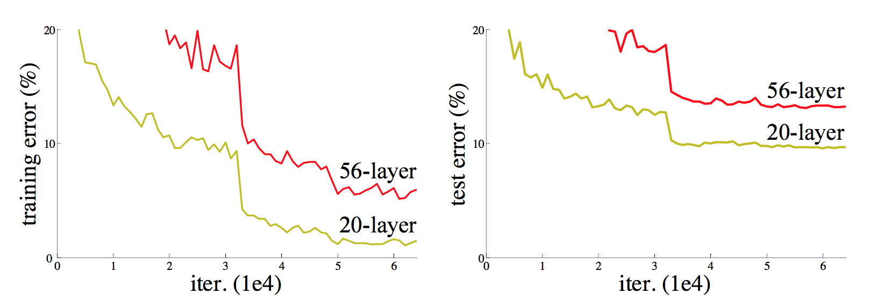
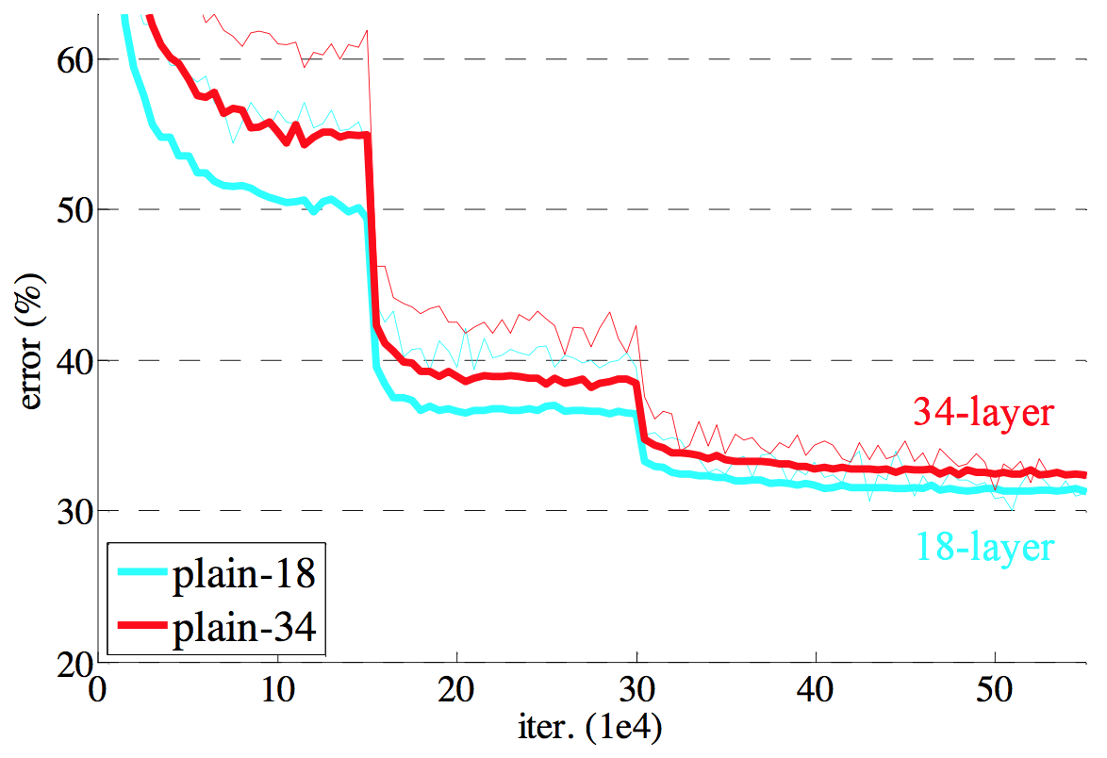
Degeneration problem
CiFAR 100 Dataset
ImageNet

Slide 5
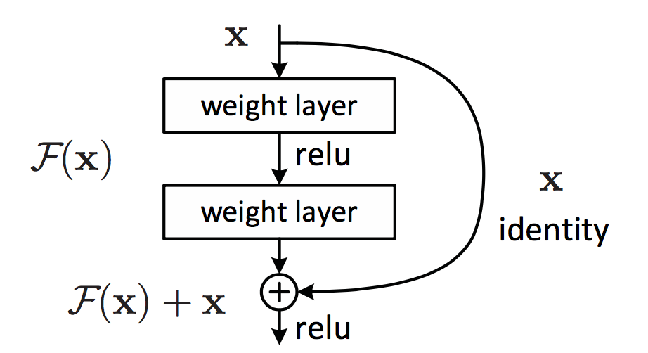
Residual learning building block

Slide 6
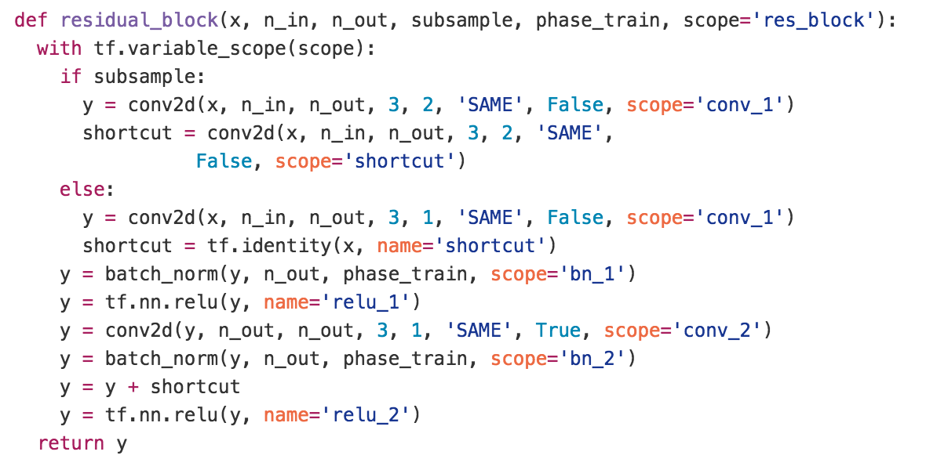
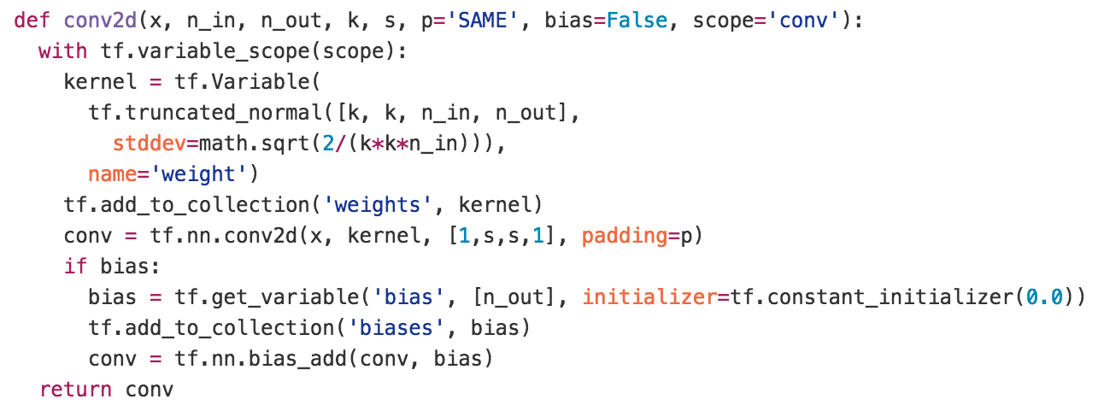
Residual learning building block
y
ReLU
+
y
conv2d
y
ReLU
y
conv2d
x

Slide 7
Why residual?
We hypothesize that it is easier to optimize the residual mapping than to optimize the original, unreferenced mapping.
Shortcut connections are used.

Slide 8
Why residual?
“The extremely deep residual nets are easy to optimize. “
“The deep residual nets can easily enjoy accuracy gains from greatly increased depth, producing results substantially better than previous networks. “

Slide 9
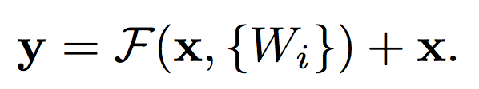
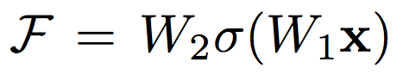
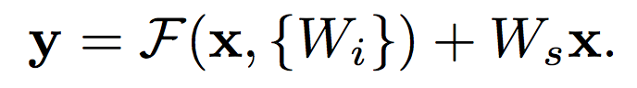
Residual mapping
Basic residual mapping (same dim.)
“But we will show by experiments that the identity mapping is sufficient for addressing the degradation problem and is economical, and thus W is only used when matching dimensions.”
Basic residual mapping (different dim.)

Slide 10
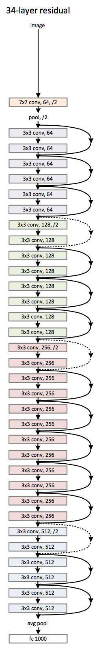
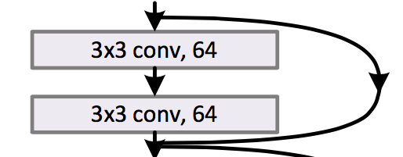
Deep residual network

Slide 11
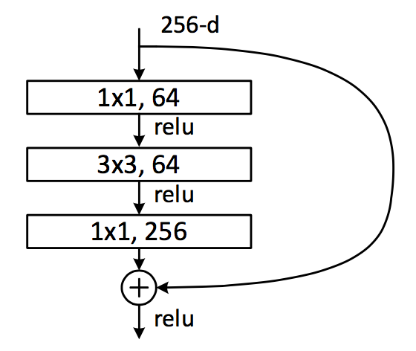
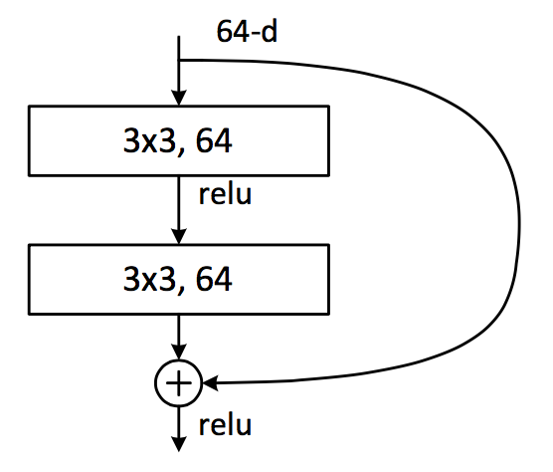
Deeper bottle architecture
Dimension reduction
Convolution
Dimension increasement

Slide 12
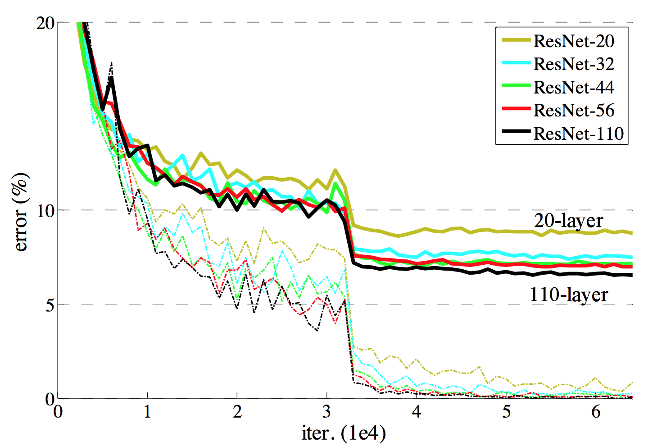
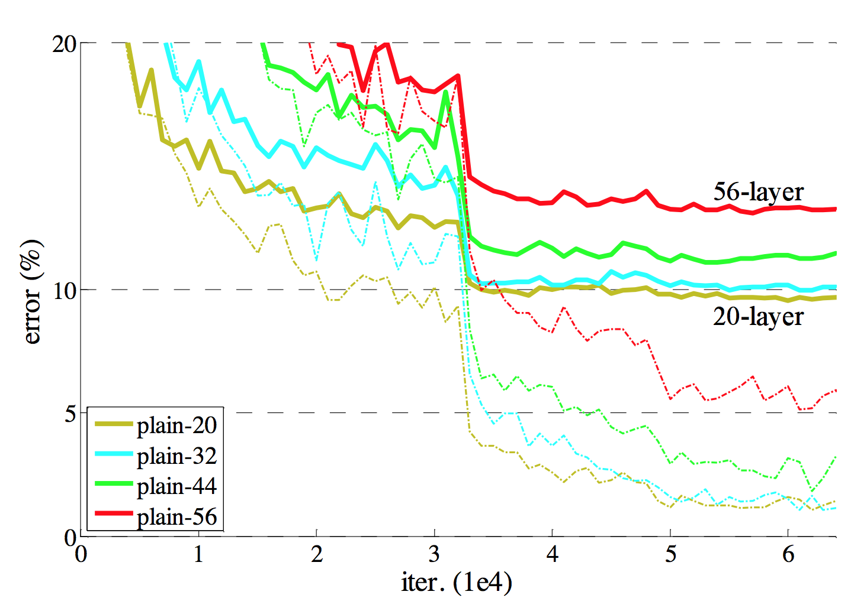
Experimental results

Slide 13
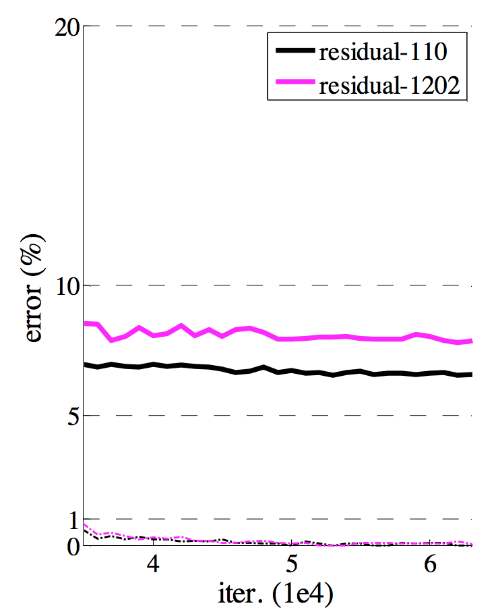
Experimental results

Slide 14

ResNet is an ensemble model
Andreas el. al. "Residual Networks are Exponential Ensembles of Relatively Shallow Networks." arXiv (2016).
Notes:
두 번째 논문.
Resnet이 잘 되는건 앙상블이라서 그런거다… 라는 얘기에 관한 내용들

Slide 15
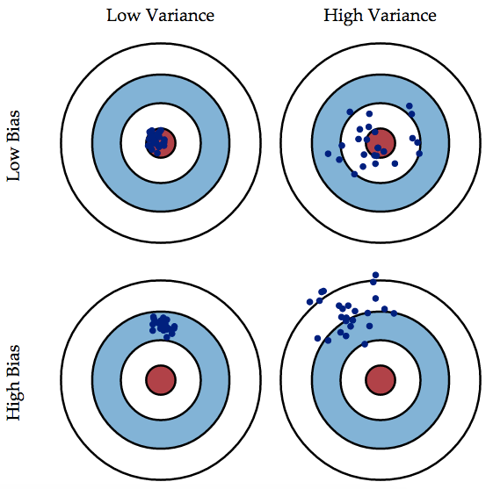
Ensemble model?
Bagging
Boosting
The Famous Bias/Variance Tradeoff

Slide 16
Bagging vs. Boosting
Bagging
Generate multiple sets of training data (with bootstrapping), multiple predictions and combine them with averaging prediction
Reduce overall variance using multiple low-bias models
Example: Random Forest
Bagging
Boosting
Boosting
Generate multiple weak learners and combine them to make a strong learner
Reduce overall bias using multiple weak learners
Example: Boosting, AdaBoost

Slide 17
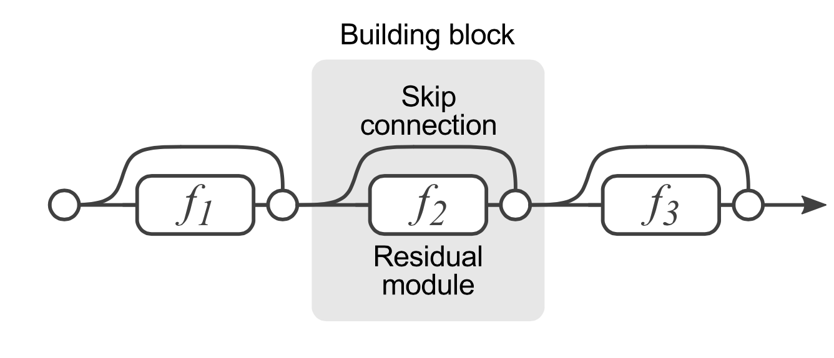
ResNet is an ensemble model?

Slide 18
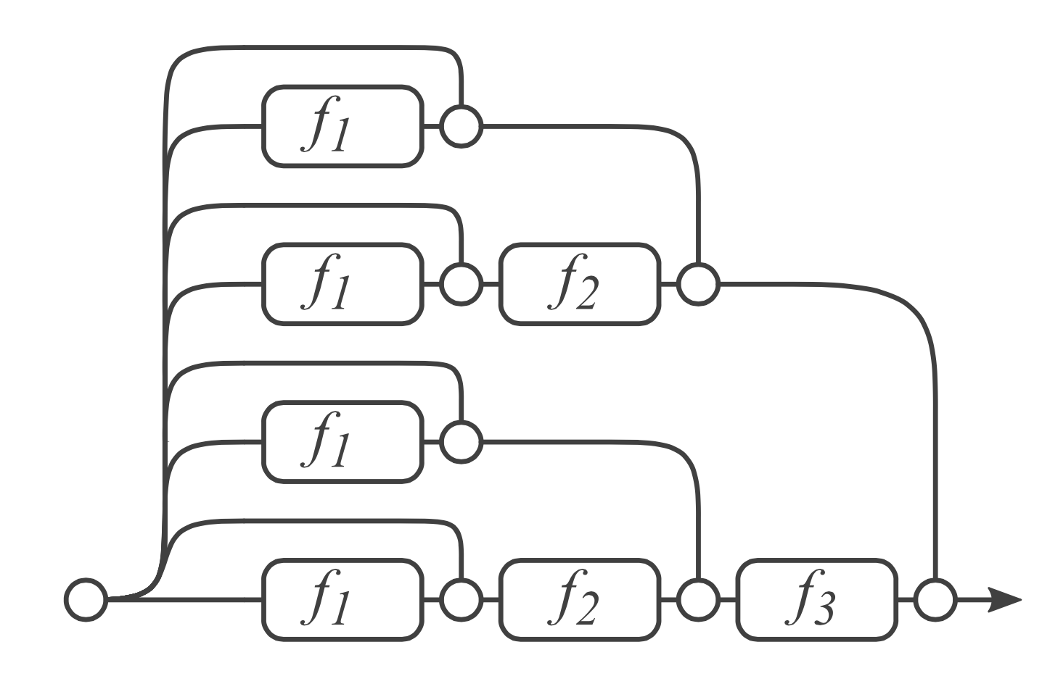
ResNet is an ensemble model?
Notes:
여기에 한개 한개의 길을 weak 분류기로 생각하기 때문에 배깅이라고 해석할 수 있단 얘기

Slide 19
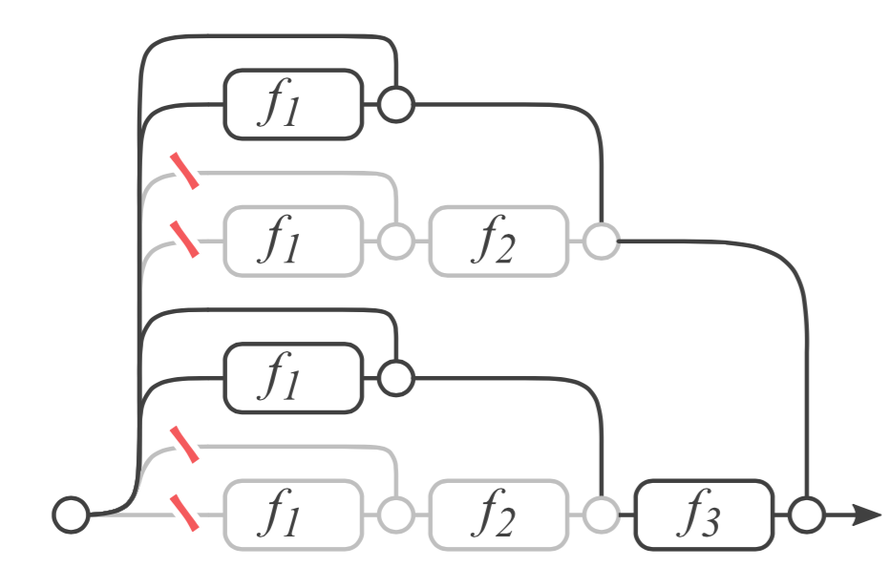
Remove a layer?
What happens if we remove the second layer?
Notes:
진짜 그런지 실험을 해보자. F2를 빼보자. 그래도 성능 잘 나오더라

Slide 20
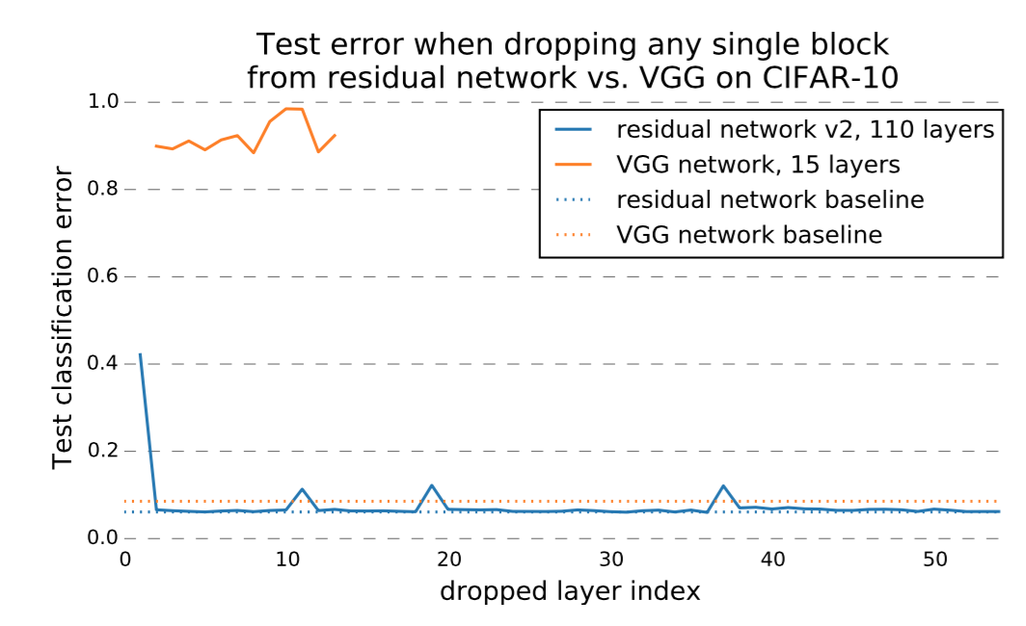
Performance?
Notes:
Vgg같은 경우에는 중간에 레이어를 아예 빼버림. -> 성능 엄청 떨어짐
튀는 부분은 아마도 maxpooling 일어나는 시점일 것으로 생각한다.
Maxpooling 레이어에서 feature transform이 일어나는 거고 중간에는 약간의 튜닝만 해준다.

Slide 21
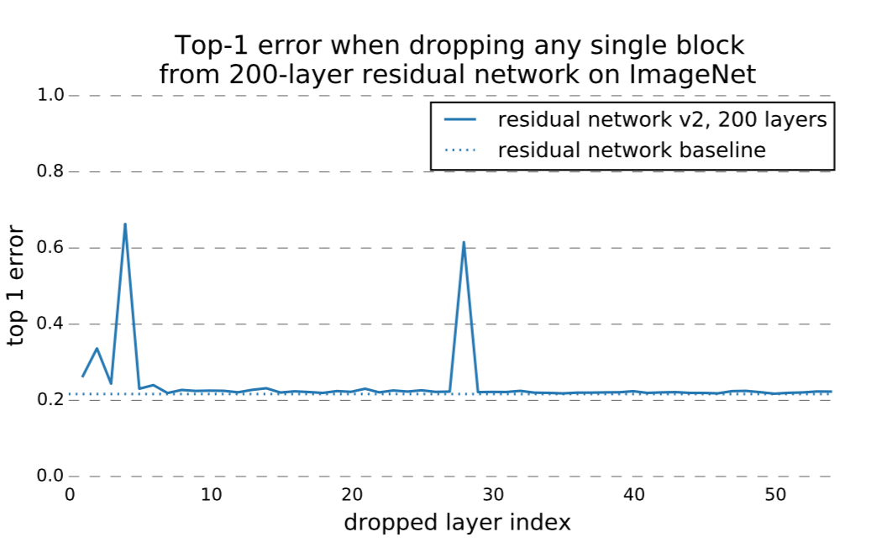
Performance?

Slide 22
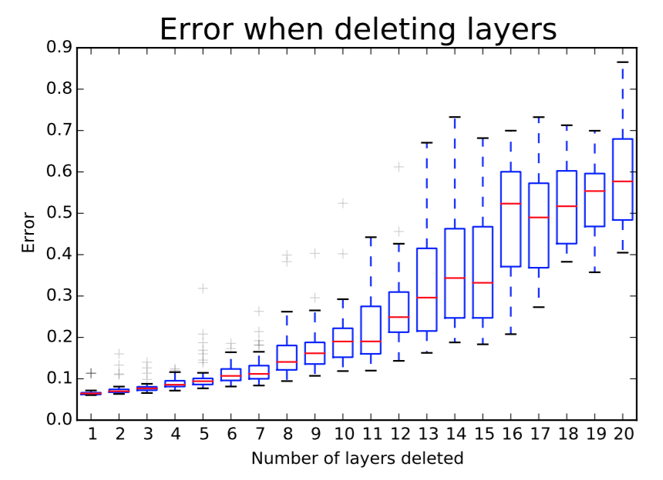
Removing multiple layers?

Slide 23
What does this mean?
“One of the characteristics of ensembles is that their performance depends smoothly on the number of members. …. This means error should decrease smoothly as we delete more residual modules. “
Notes:
어찌 보면 용두사미

Slide 24
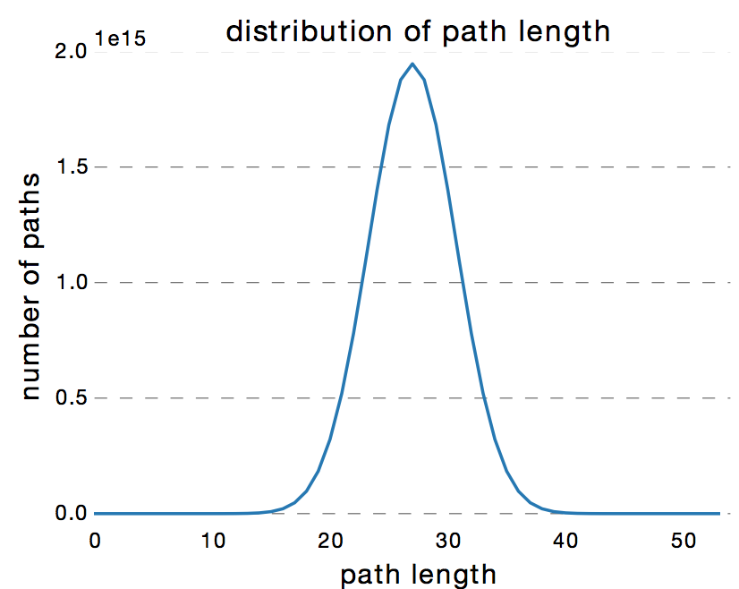
Ensemble of shallow nets?
Path distribution follows a Binomial distribution.
More than 95% of paths go through 19 to 35 modules.
Notes:
52개 중 35개가 90% 차지한다. 결국 부분만 사용. -> shallow하다는 얘기
근데 30개 정도면 deep 아냐? ㅋ

Slide 25
Depth is NOT that important
Zagoruyko, Sergey, and Nikos Komodakis. "Wide Residual Networks." arXiv (2016).
Notes:
Resnet을 정면으로 반박하는 얘기에 대한 내용.
Width는 필터 개수 얘기
K – 필터의 개수 depth

Slide 26
Depth vs. width
“The authors of residual networks tried to make them as thin as possible in favor of increasing their depth and having less parameters, and even introduced a «bottleneck» block which makes ResNet blocks even thinner.”
“We note, however, that the residual block with identity mapping that allows to train very deep networks is at the same time a weakness of residual networks. As gradient flows through the network there is nothing to force it to go through residual block weights and it can avoid learning anything during training, so it is possible that there is either only a few blocks that learn useful representations, or many blocks share very little information with small contribution to the final goal.”
Notes:
레스넷 얘기는 depth, 레이어 깊이 개수를 늘리고 필터 개수 width, k를 최대한 작게 유지해주려고 노력하는 구조다.

Slide 27
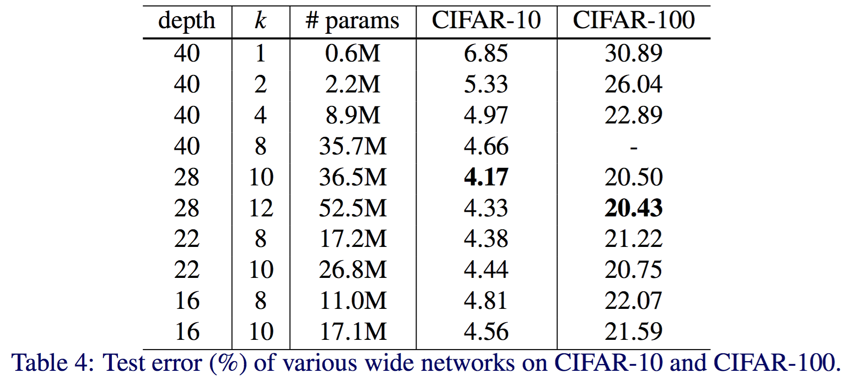
Experimental results
Notes:
어느 정도 까지는 k 즉 width를 늘리는게 좋더라. 여기서는 28-10 조합

Slide 28
Experimental results
Notes:
Width가 동일할 때 Depth가 줄어드는데도 성능은 좋아졌다.

Slide 29
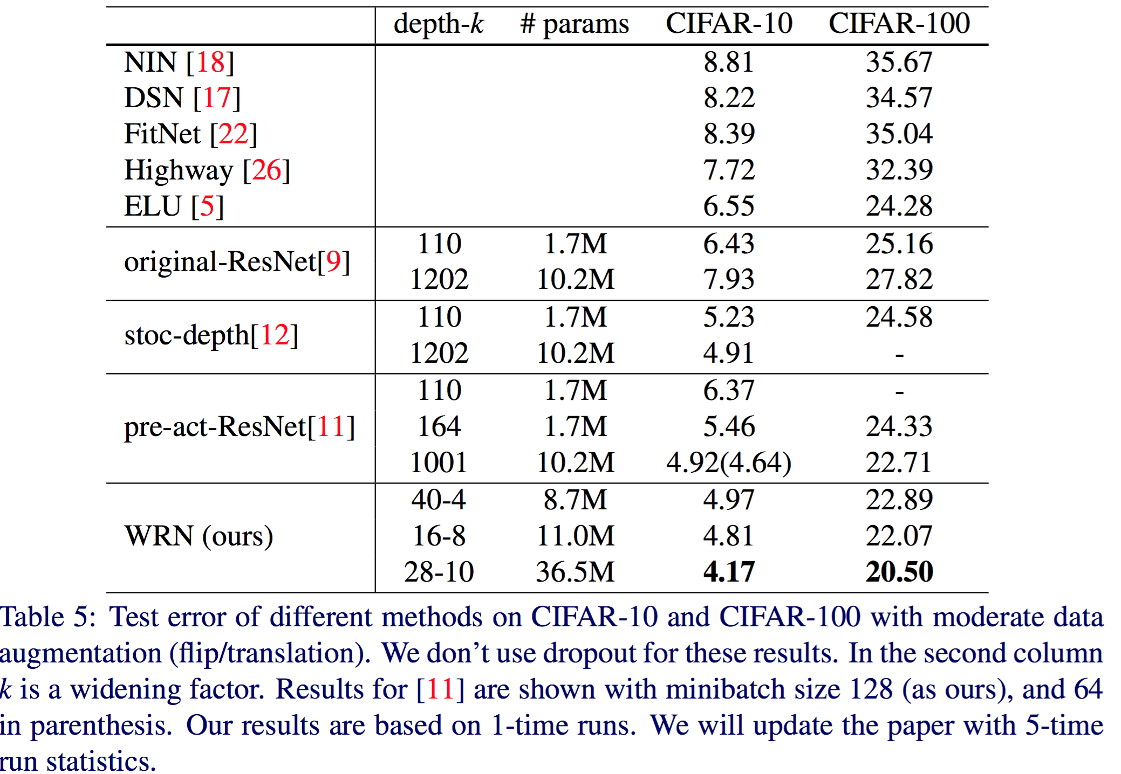
Experimental results
8 times faster to train
Notes:
저 두 개가 가장 좋은건데 depth 차이가 1000과 40인데 성능은 거의 비슷하다.
K를 키우는게 더 좋다. 왜냐하면 속도 차이, 또한 깊이가 깊어질 수록 학습에 여러가지로 어려움이 생긴다.

Slide 30
Experimental results

Slide 31
Summary
Widening consistently improves performance across residual networks of different depth
Increasing both depth and width helps until the number of parameters becomes too high and stronger regularization is needed
Wide networks can successfully learn with a 2 or more times larger number of parameters than thin ones, which would re-quire doubling the depth of thin networks, making them infeasibly expensive to train.

